Slide 1
The First Step to MatLab
Wenbo ZHANG
School of Science, BUPT
zhangwb_wk@163.com

Slide 2
Overview of MATLAB system
Starting and Quitting MATLAB
Matrices in MATLAB
Expressions in MATLAB
Working with Matrices
Controlling Command Window Input and Output

Slide 3
Overview of the MATLAB® Environment
The MATLAB® high-performance language for technical computing integrates computation, visualization, and programming in an easy-to-use environment where problems and solutions are expressed in familiar mathematical notation. Typical uses include
Math and computation
Algorithm development
Data acquisition
Modeling, simulation, and prototyping
Data analysis, exploration, and visualization
Scientific and engineering graphics
Application development, including graphical user interface building

Slide 4
Overview of the MATLAB® Environment
MATLAB is an interactive system whose basic data element is an array that does not require dimensioning. It allows you to solve many technical computing problems, especially those with matrix and vector formulations, in a fraction of the time it would take to write a program in a scalar noninteractive language such as C or Fortran.
The name MATLAB stands for matrix laboratory. MATLAB was originally written to provide easy access to matrix software developed by the LINPACK and EISPACK projects. Today, MATLAB engines incorporate the LAPACK and BLAS libraries, embedding the state of the art in software for matrix computation.

Slide 5
Overview of the MATLAB® Environment
MATLAB has evolved over a period of years with input from many users. In university environments, it is the standard instructional tool for introductory and advanced courses in mathematics, engineering, and science. In industry, MATLAB is the tool of choice for high-productivity research, development, and analysis.
MATLAB features a family of add-on application-specific solutions called toolboxes. Toolboxes allow you to learn and apply specialized technology. Toolboxes are comprehensive collections of MATLAB functions (M-files). You can add on toolboxes for signal processing, control systems, neural networks, fuzzy logic, wavelets, simulation, and many other areas.

Slide 6
The MATLAB® System
The MATLAB system consists of these main parts:
Desktop Tools and Development Environment
Mathematical Function Library
The Language
Graphics
External Interfaces

Slide 7
The MATLAB® System Desktop Tools and Development Environment
This is the set of tools and facilities that help you use and become more productive with MATLAB functions and files. Many of these tools are graphical user interfaces. It includes the MATLAB desktop and Command Window, a command history, an editor and debugger, a code analyzer and other reports, and browsers for viewing help, the workspace, files, and the search path.

Slide 8
The MATLAB® System Mathematical Function Library
This is a vast collection of computational algorithms ranging from elementary functions, like sum, sine, cosine, and complex arithmetic, to more sophisticated functions like matrix inverse, matrix eigenvalues, Bessel functions, and fast Fourier transforms.

Slide 9
The MATLAB® System The Language
This is a high-level matrix/array language with control flow statements, functions, data structures, input/output, and object-oriented programming features. It allows both ”programming in the small” to rapidly create quick and dirty throw-away programs, and ”programming in the large” to create large and complex application programs.

Slide 10
The MATLAB® System Graphics
MATLAB has extensive facilities for displaying vectors and matrices as graphs, as well as annotating and printing these graphs. It includes high-level functions for two-dimensional and three-dimensional data visualization, image processing, animation, and presentation graphics.
It also includes low-level functions that allow you to fully customize the appearance of graphics as well as to build complete graphical user interfaces on your MATLAB applications.

Slide 11
The MATLAB® System External Interfaces
This is a library that allows you to write C and Fortran programs that interact with MATLAB. It includes facilities for calling routines from MATLAB (dynamic linking), for calling MATLAB as a computational engine, and for reading and writing MAT-files.

Slide 12
Starting and Quitting MATLAB®
After the installation, you can start MATLAB by double clicking the icon on your Windows desktop or search for the program shortcut from the program menu of Windows.
While quitting MATLAB, you can type quit in the command window or choose
File > Exit MATLAB
from the menu of MATLAB.

Slide 13
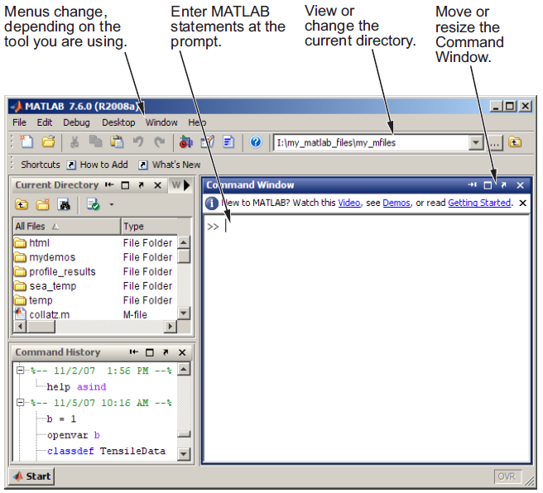
The Desktop

Slide 14
Matrices

Slide 15
About Matrices
Entering Matrices
Operation on Matrices
Subscripts
The Colon Operator

Slide 16
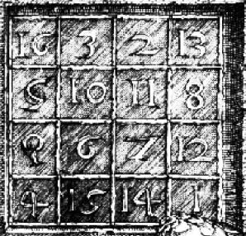
About Matrices
In the MATLAB® environment, a matrix is a rectangular array of numbers. Special meaning is sometimes attached to 1-by-1 matrices, which are scalars, and to matrices with only one row or column, which are vectors. MATLAB has other ways of storing both numeric and nonnumeric data, but in the beginning, it is usually best to think of everything as a matrix. The operations in MATLAB are designed to be as natural as possible. Where other programming languages work with numbers one at a time, MATLAB allows you to work with entire matrices quickly and easily.

Slide 17
Entering Matrices
The best way for you to get started with MATLAB is to learn how to handle matrices.
You can enter matrices into MATLAB in several different ways:
Enter an explicit list of elements.
Load matrices from external data files.
Generate matrices using built-in functions.
Create matrices with your own functions in M-files.

Slide 18
Entering Matrices
Let’s start by entering a simple matrix as a list of its elements. You only have to follow a few basic conventions:
Separate the elements of a row with blanks or commas.
Use a semicolon, ; , to indicate the end of each row.
Surround the entire list of elements with square brackets, [ ].

Slide 19
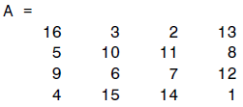
Entering Matrices
Example
To enter a matrix, simply type in the Command Window
A = [16 3 2 13; 5 10 11 8; 9 6 7 12; 4 15 14 1]
MATLAB displays the matrix you just entered:
This matrix matches the numbers in the engraving. Once you have entered the matrix, it is automatically remembered in the MATLAB workspace. You can refer to it simply as A.

Slide 20
Operation on Matrices sum, transpose, and diag
You are probably already aware that the special properties of a magic square have to do with the various ways of summing its elements. If you take the sum along any row or column, or along either of the two main diagonals, you will always get the same number. Let us verify that using MATLAB. The first statement to try is
sum(A)
MATLAB replies with
ans =
34 34 34 34
When you do not specify an output variable, MATLAB uses the variable ans, short for answer, to store the results of a calculation.

Slide 21
Operation on Matrices sum, transpose, and diag
How about the row sums? MATLAB has a preference for working with the columns of a matrix, so one way to get the row sums is to transpose the matrix, compute the column sums of the transpose, and then transpose the result. For an additional way that avoids the double transpose use the dimension argument for the sum function.
MATLAB has two transpose operators. The apostrophe operator (e.g., A’) performs a complex conjugate transposition. It flips a matrix about its main diagonal, and also changes the sign of the imaginary component of any complex elements of the matrix. The dot-apostrophe operator (e.g., A.’), transposes without affecting the sign of complex elements. For matrices containing all real elements, the two operators return the same result.

Slide 22
Operation on Matrices sum, transpose, and diag
The sum of the elements on the main diagonal is obtained with the sum and the diag functions:
diag(A)
ans =
16
10
7
1
sum(diag(A))
ans =
34

Slide 23
Operation on Matrices sum, transpose, and diag
The other diagonal, the so-called antidiagonal, is not so important mathematically, so MATLAB does not have a ready-made function for it. But a function originally intended for use in graphics, fliplr, flips a matrix from left to right:
sum(diag(fliplr(A)))
ans =
34

Slide 24
Subscripts
The element in row i and column j of A is denoted by A(i,j). For example, A(4,2) is the number in the fourth row and second column. For our magic square, A(4,2) is 15. So to compute the sum of the elements in the fourth column of A, type
A(1,4) + A(2,4) + A(3,4) + A(4,4)
ans =
34

Slide 25
Subscripts
It is also possible to refer to the elements of a matrix with a single subscript, A(k). This is the usual way of referencing row and column vectors. But it can also apply to a fully two-dimensional matrix, in which case the array is regarded as one long column vector formed from the columns of the original matrix. So, for our magic square, A(8) is another way of referring to the value 15 stored in A(4,2).
If you try to use the value of an element outside of the matrix, it is an error:
t = A(4,5)
??? Attempted to access A(4,5); index out of bounds because size(A)=[4,4].

Slide 26
Subscripts
On the other hand, if you store a value in an element outside of the matrix, the size increases to accommodate the newcomer:
X = A;
X(4,5) = 17
X =
16 3 2 13 0
5 10 11 8 0
9 6 7 12 0
4 15 14 1 17

Slide 27
The Colon Operator
The colon, :, is one of the most important MATLAB operators. It occurs in several different forms. The expression
1:10
is a row vector containing the integers from 1 to 10:
ans =
1 2 3 4 5 6 7 8 9 10
To obtain nonunit spacing, specify an increment. For example,
100:-7:50
ans =
100 93 86 79 72 65 58 51

Slide 28
The Colon Operator
Subscript expressions involving colons refer to portions of a matrix:
A(1:k,j)
is the first k elements of the jth column of A. So
sum(A(1:4,4))
computes the sum of the fourth column. There also an other better way to do this
sum(A(:,end))
computes the sum of the elements in the last column of A.

Slide 29
The Colon Operator
Command
A(:,[1,3,2,4])
will generate a new matrix with the two middle columns swapped and
A([1,3,2,4], :)
produces a new matrix with the two middle rows swapped.

Slide 30
Expression

Slide 31
Variables
Numbers
Operators
Functions

Slide 32
Variables
Like most other programming languages, the MATLAB® language provides mathematical expressions, but unlike most programming languages, these expressions involve entire matrices.
MATLAB does not require any type declarations or dimension statements. When MATLAB encounters a new variable name, it automatically creates the variable and allocates the appropriate amount of storage. If the variable already exists, MATLAB changes its contents and, if necessary, allocates new storage. For example,
num_students = 25

Slide 33
Variables
Variable names consist of a letter, followed by any number of letters, digits, or underscores. MATLAB is case sensitive; it distinguishes between uppercase and lowercase letters. A and a are not the same variable.
Although variable names can be of any length, MATLAB uses only the first N characters of the name, (where N is the number returned by the function namelengthmax), and ignores the rest. Hence, it is important to make each variable name unique in the first N characters to enable MATLAB to distinguish variables.

Slide 34
Numbers
MATLAB uses conventional decimal notation, with an optional decimal point and leading plus or minus sign, for numbers. Scientific notation uses the letter e to specify a power-of-ten scale factor. Imaginary numbers use either i or j as a suffix.
3 -99 0.0001
9.6397238 1.60210e-20 6.02252e23
1i -3.14159j 3e5i
All numbers are stored internally using the long format specified by the IEEE® floating-point standard. Floating-point numbers have a finite precision of roughly 16 significant decimal digits and a finite range of roughly 10⁻³⁰⁸ to 10⁺³⁰⁸.

Slide 35
Operators
Expressions use familiar arithmetic operators and precedence rules.
+ Addition
- Subtraction
* Multiplication
/ Division
\ Left division
^ Power
' Complex conjugate transpose
( ) Specify evaluation order

Slide 36
Functions
MATLAB provides a large number of standard elementary mathematical functions, including abs, sqrt, exp, and sin. Taking the square root or logarithm of a negative number is not an error; the appropriate complex result is produced automatically. For a list of the elementary mathematical functions, type
help elfun
Some of the functions, like sqrt and sin, are built in. Built-in functions are part of the MATLAB core so they are very efficient, but the computational details are not readily accessible. Other functions, like gamma and sinh, are implemented in M-files.

Slide 37
Functions
Several special functions provide values of useful constants.
pi 3.14159265...
i Imaginary unit
j Same as i
eps Floating-point relative precision, ε = 2⁻⁵²
Inf Infinity
NaN Not-a-number
realmin Smallest floating-point number, 2⁻¹⁰²²
realmax Largest floating-point number,
(2- ε) 2¹⁰²³

Slide 38
Functions
The function names are not reserved. It is possible to overwrite any of them with a new variable, such as
eps = 1. e -6
and then use that value in subsequent calculations. The original function can be restored with
clear eps

Slide 39
Working with Matrices

Slide 40
Generating Matrices
The load Function
M-Files
Concatenation
Deleting Rows and Columns

Slide 41
Generating Matrices
MATLAB® software provides four functions that generate basic matrices.
zeros All zeros
ones All ones
rand Uniformly distributed random elements
randn Normally distributed random elements

Slide 42
The load Function
The load function reads binary files containing matrices generated by earlier MATLAB sessions, or reads text files containing numeric data. The text file should be organized as a rectangular table of numbers, separated by blanks, with one row per line, and an equal number of elements in each row.
For example, outside of MATLAB, create a text file containing these four lines:
16.0 3.0 2.0 13.0
5.0 10.0 11.0 8.0
9.0 6.0 7.0 12.0
4.0 15.0 14.0 1.0
An easy way to read data into MATLAB from many text or binary formats is to use the Import Wizard.

Slide 43
M-Files
You can create your own matrices using M-files, which are text files containing MATLAB code. Use the MATLAB Editor or another text editor to create a file containing the same statements you would type at the MATLAB command line. Save the file under a name that ends in .m.

Slide 44
Concatenation
Concatenation is the process of joining small matrices to make bigger ones. In fact, you made your first matrix by concatenating its individual elements. The pair of square brackets, [ ], is the concatenation operator.
For an example, start with the 4-by-4 magic square, A, and form
B = [A A+32; A+48 A+16]
The result is an 8-by-8 matrix, obtained by joining the four submatrices.

Slide 45
Deleting Rows and Columns
You can delete rows and columns from a matrix using just a pair of square brackets.
To delete the second column of X, use
X(:,2) = [ ]
If you delete a single element from a matrix, the result is not a matrix anymore. So you get an error.
X(1,2) = [ ]

Slide 46
Deleting Rows and Columns
However, using a single subscript deletes a single element,
or sequence of elements, and reshapes the remaining elements into a row vector.
X(2:2:10) = [ ]
result is …

Slide 47
More About Matrices and Arrays

Slide 48
Linear Algebra
Arrays
Multivariate Data
Scalar Expansion
Logical Subscripting
The find Function

Slide 49
Linear Algebra
Informally, the terms matrix and array are often used interchangeably. More precisely, a matrix is a two-dimensional numeric array that represents a linear transformation. The mathematical operations defined on matrices are the subject of linear algebra.
Dürer’s magic square
A = [ 16 3 2 13
5 10 11 8
9 6 7 12
4 15 14 1 ]
provides several examples that give a taste of MATLAB® matrix operations.

Slide 50
Linear Algebra
You have already seen the matrix transpose, A'. Adding a matrix to its transpose produces a symmetric matrix:
A + A’
The multiplication symbol, *, denotes the matrix multiplication involving inner products between rows and columns. Multiplying the transpose of a matrix by the original matrix also produces a symmetric matrix:
A’ * A

Slide 51
Linear Algebra
The determinant of this particular matrix happens to be zero, indicating that the matrix is singular:
d = det(A)
The reduced row echelon form of A is not the identity:
R = rref(A)
Since the matrix is singular, it does not have an inverse. If you try to compute the inverse with
X = inv(A)
you will get a warning message.

Slide 52
Linear Algebra
The eigenvalues of the magic square are interesting:
e = eig(A)
One of the eigenvalues is zero, which is another consequence of singularity. The largest eigenvalue is 34, the magic sum. That is because the vector of all ones is an eigenvector:
v = ones(4,1)
A * v

Slide 53
Linear Algebra
When a magic square is scaled by its magic sum,
P = A / 34
the result is a doubly stochastic matrix whose row and column sums are all 1.
P =
0.4706 0.0882 0.0588 0.3824
0.1471 0.2941 0.3235 0.2353
0.2647 0.1765 0.2059 0.3529
0.1176 0.4412 0.4118 0.0294

Slide 54
Linear Algebra
Such matrices represent the transition probabilities in a Markov process. Repeated powers of the matrix represent repeated steps of the process. For our example, the fifth power
P^5
Finally, the coefficients in the characteristic polynomial can be found by
poly(A)

Slide 55
Arrays
When they are taken away from the world of linear algebra, matrices become two-dimensional numeric arrays. Arithmetic operations on arrays are done element by element. This means that addition and subtraction are the same for arrays and matrices, but that multiplicative operations are different. MATLAB uses a dot, or decimal point, as part of the notation for multiplicative array operations.

Slide 56
Arrays
A list of operators includes
+ Addition
- Subtraction
.* Element-by-element multiplication
./ Element-by-element division
.\ Element-by-element left division
.^ Element-by-element power
.' Unconjugated array transpose
If the Dürer magic square is multiplied by itself with array multiplication
A .* A

Slide 57
Building Tables
Array operations are useful for building tables. Suppose n is the column vector
n = (0:9)’
Then
pows = [n n.^2 2.^n]
builds a table of squares and powers of 2.

Slide 58
Scalar Expansion
Matrices and scalars can be combined in several different ways. For example, a scalar is subtracted from a matrix by subtracting it from each element. The average value of the elements in our magic square is 8.5, so
B = A – 8.5
forms a matrix whose column sums are zero:
B =
7.5 -5.5 -6.5 4.5
-3.5 1.5 2.5 -0.5
0.5 -2.5 -1.5 3.5
-4.5 6.5 5.5 -7.5
sum(B)
ans =
0 0 0 0

Slide 59
Scalar Expansion
With scalar expansion, MATLAB assigns a specified scalar to all indices in a range. For example,
B(1:2,2:3) = 0
zeroes out a portion of B:
B =
7.5 0 0 4.5
-3.5 0 0 -0.5
0.5 -2.5 -1.5 3.5
-4.5 6.5 5.5 -7.5

Slide 60
Logical Subscripting
The logical vectors created from logical and relational operations can be used to reference subarrays. Suppose X is an ordinary matrix and L is a matrix of the same size that is the result of some logical operation. Then X(L) specifies the elements of X where the elements of L are nonzero.
This kind of subscripting can be done in one step by specifying the logical operation as the subscripting expression. Suppose you have the following set of data:
x = [2.1 1.7 1.6 1.5 NaN 1.9 1.8 1.5 5.1 1.8 1.4 2.2 1.6 1.8];
The NaN is a marker for a missing observation, such as a failure to respond to an item on a questionnaire.

Slide 61
Logical Subscripting
To remove the missing data with logical indexing, use isfinite(x), which is true for all finite numerical values and false for NaN and Inf:
x = x(isfinite(x))
x =
2.1 1.7 1.6 1.5 1.9 1.8 1.5 5.1 1.8 1.4 2.2 1.6 1.8
Now there is one observation, 5.1, which seems to be very different from the others. It is an outlier. The following statement removes outliers, in this case those elements more than three standard deviations from the mean:
x = x(abs(x-mean(x)) <= 3*std(x))
x =
2.1 1.7 1.6 1.5 1.9 1.8 1.5 1.8 1.4 2.2 1.6 1.8

Slide 62
The find Function
The find function determines the indices of array elements that meet a given logical condition. In its simplest form, find returns a column vector of indices. Transpose that vector to obtain a row vector of indices.

Slide 63
Controlling Command Window Input and Output

Slide 64
The format Function
Suppressing Output
Entering Long Statements
Command Line Editing

Slide 65
The format Function
The format function controls the numeric format of the values displayed. The function affects only how numbers are displayed, not how MATLAB® software computes or saves them. Here are the different formats, together with the resulting output produced from a vector x with components of different magnitudes.
short
short e
short g
long
long e
long g
bank
rat
hex

Slide 66
The format Function
In addition to the format functions shown before
format compact
suppresses many of the blank lines that appear in the output. This lets you view more information on a screen or window. If you want more control over the output format, use the sprintf and fprintf functions.

Slide 67
Suppressing Output
If you simply type a statement and press Return or Enter, MATLAB automatically displays the results on screen. However, if you end the line with a semicolon, MATLAB performs the computation but does not display any output. This is particularly useful when you generate large matrices.

Slide 68
Entering Long Statements
If a statement does not fit on one line, use an ellipsis (three periods), ..., followed by Return or Enter to indicate that the statement continues on the next line.

Slide 69
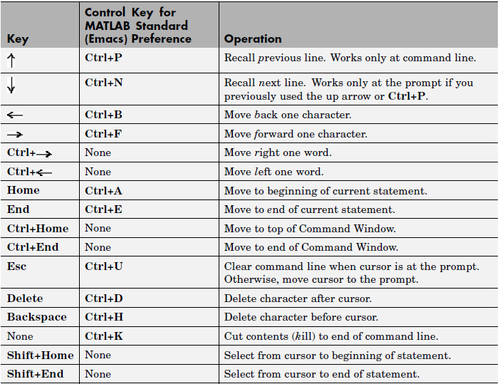
Command Line Editing

